Slide 1
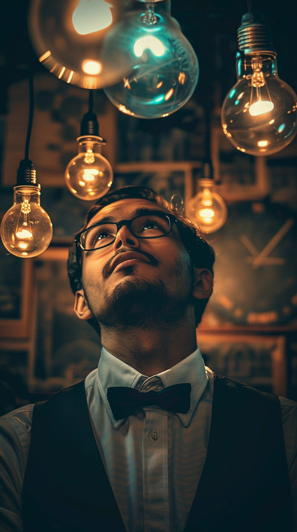
Principle 1 Ideas belong to everyone

Slide 2
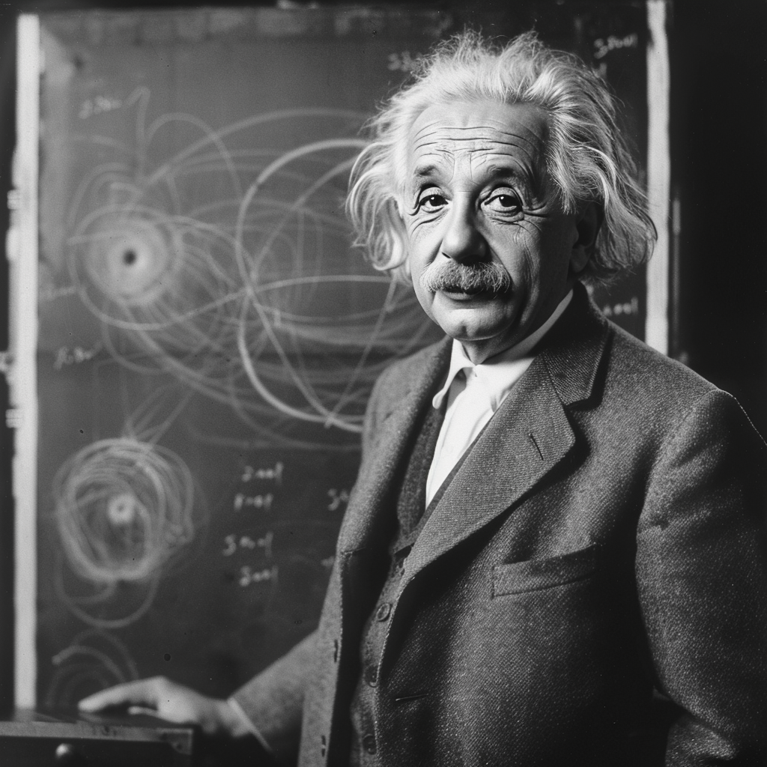
A century ago
Einstein discovered That mass is energy and mass is curving space

Slide 3
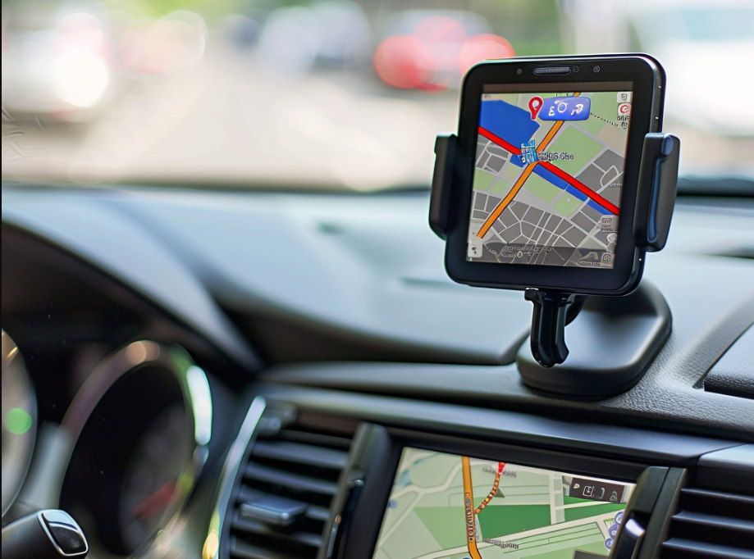
Without his discoveries
No GPS

Slide 4
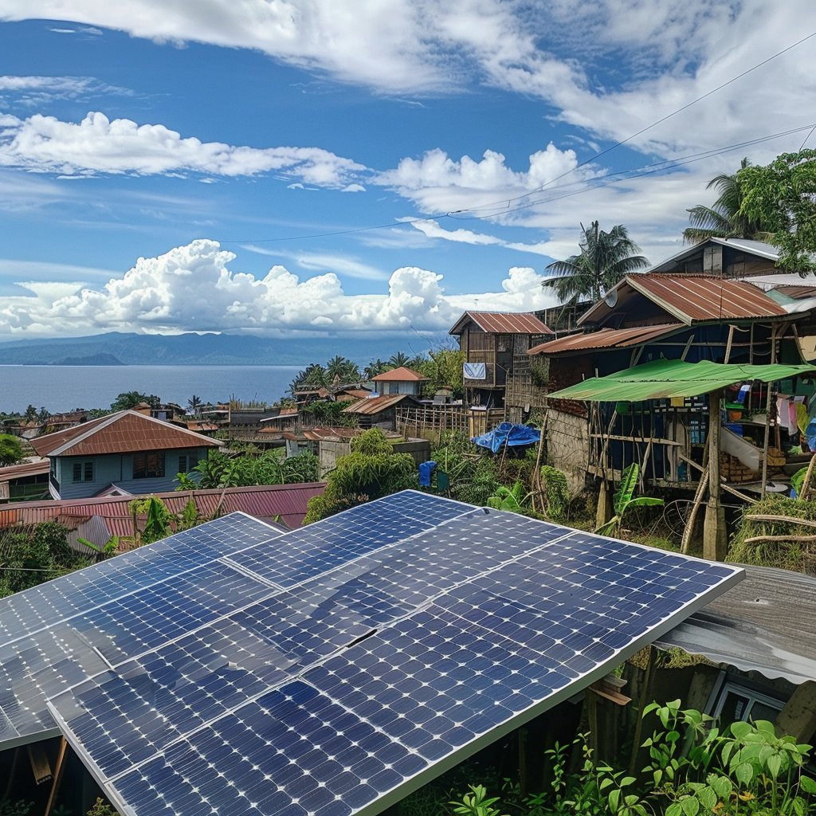
No solar panels

Slide 5
But no one pay him or his descendants when we use those discoveries !

Slide 6
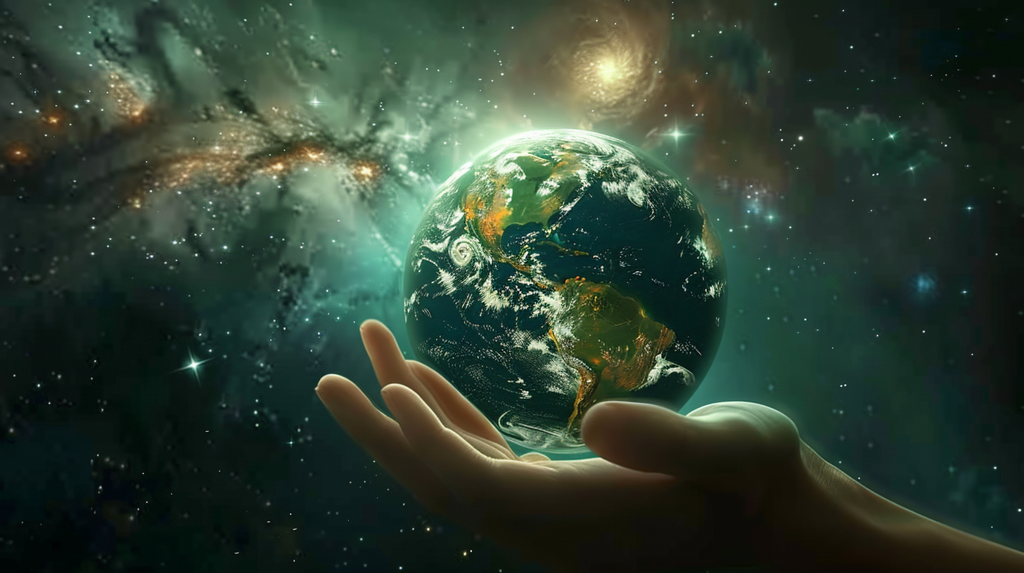
It is a gift to humanity.

Slide 7
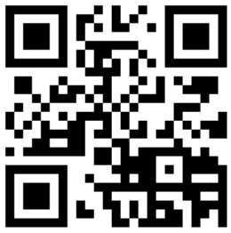
Join la Liga !
Do you really think this can happen without you ?
la-liga.ph

